Slide 1
Some Design Considerations for Low-cost (under $1000), Flexible, High-performance (T_{SYS} < 100 ⁰K & Δf/f better than ≈ 1:10¹¹ -1:10¹²) X-band (10.45 GHz) Receive Terminals for AMSAT’s GEO, HEO and Lunar Missions
Tom Clark, K3IO
K3IO@AMSAT.ORG
17 October 2015

Slide 2
Some Design Considerations that I Adopted
Most Amateurs do not have microwave hardware & test equipment,
Most Amateurs have little microwave expertise,
Most Amateurs are cheap bastards,
AMSAT wants to appeal to a wide range of Amateur Interests,
AMSAT has a vision to revolutionize “First Responder” EMCOMM
Any design must be easily replicable in order to be widely acceptable,
High-performance SDRs have become commonplace and are in daily use by amateurs,
And Vendors like AMAZON stock lots of useful widgets including small dishes & Ku-band LNBs (complete LNA+LO+Feed modules).

Slide 3
And further, especially for the GEO case,
Spacecraft will be visible 24/7 & required antenna motion is small.
This means that “Armstrong Rotors” with manual pointing updates are feasible.
Therefore no mechanized “prime movers” have been incorporated.
Mechanically-minded “hackers” are welcome to innovate !
The current GEO mission calls for a C-band TX uplink; the C-band TX frequency is ≈ ½ of the X-band downlink.
Full duplex TX/RX operation will be HIGHLY desired.
The PHEMT transistors in the front-end of the LNB are quite zappable (like -40 dBm)
TX/RX crossband isolation in C/X dual-mode feeds is likely to be woefully inadequate.
Therefore I recommend isolated, separate small TX & RX dish antennas.
Implement the X-band RX terminal first, listen to the GEO bird, and then if you are still interested build the the C-band uplink TX system.
The X-band RX terminal will also allow you to participate in telemetry gathering and tracking to support POD of the Lunar Cubesat mission (listen to Luigi Balarinni & Ragnarok in an hour+ for more details).

Slide 4
Using Ku-band LNBs at X-band
The “FTA” TVRO market in Europe & the Middle East has led to the development of low-cost Ku-band Dual-band LNBs costing $8-25.
Advertised at 0.1-0.2 dB NF, but in reality more like 0.5-1.0 dB with PHEMT LNA
Advertised Low-band = 10.7-11.9: Apply +12v and 1st LO = 9.75 GHz, xtal controlled. 10.45 comes out at 700 MHz IF down ~10 dB (our of 70 dB) in gain
Advertised Hi-band = 11.5-12.75: Apply +18v & 1st LO = 10.6 GHz (same xtal)
Single channel linear polarized feed, or dual channel with 2 LNAs dual polarized. Dual costs ~$5-10 more but it gives you a hot spare.
Be sure to get “PLL” xtal controlled version. Older versions (including old Dish & DirectTV) used a free-running 10 GHz DRO/cavity LO and had poorer LNAs
These LNBs with 60 cm dishes have copied signals off the moon on 10.368 MHz

Slide 5
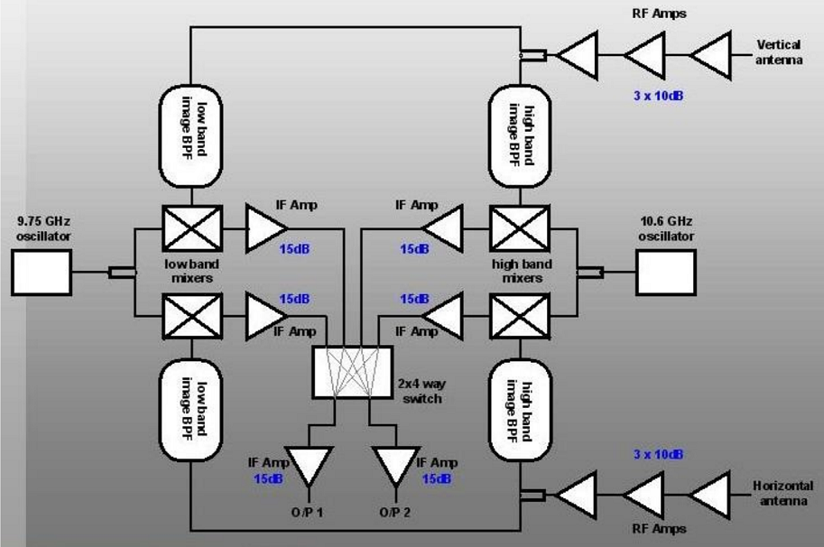
Typical LNB Bloc Courtesy http://www.earf.co.uk/sat.pdf

Slide 6
High Accuracy Frequency Addition for Lunar Quest
Make unipolar short pulses from a precision 10 MHz frequency reference (i.e. GPSDO or Rb standard)
Duration of pulses ~20 psec makes harmonics every 10 MHz up to 10 GHz.
Pulses can be made in high-speed (i.e. PECL) logic or tunnel diodes or step-recovery diodes.
Radiate signals into the LNA continuously
Process these “rails” in SDR in parallel with desired X-band signals.
Voila – your frequency standard (GPSDO) is now providing the “real” LO signal thru the entire receive chain with little/no degradation of accuracy.

Slide 7
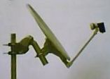
Low Cost AMSAT X-Band Ground Terminal K3IO 8/2015
Putting it all together
Small
Dipole
Radiator
LNB = Feed + LNA + LO
➔ 700 MHz IF
TLM DATA
+ DOPPLER
+ COMM
-to-
User & Analysis
~700 MHz IF + DC
SDR =
GNU RADIO
10 MHz
10 MHz GPSDO
-or-
GPS + Rb Freq Std
10 MHz Comb
Generator

Slide 8
Transportable Terminal for First Responders
AMSAT wants to develop EMCOMM as a major focus of the GEO mission
FEMA & ARRL have signed an MOU for mutual assistance
FEMA Director Fugate is a ham.
ARRL is assembling 100 Rapid Response Communications “Go Boxes” to be made available for FEMA use in major emergencies
FEMA is “supporting” GEO mission with USAF to secure rideshare ride
AMSAT is on the hook to develop 100 GEO terminals for “Go Boxes”, with $1k cost target. The design presented here is a prototype for RX half.
Design and/or copies will be made available to amateur community (following the “TAPR Model”)
COTS Tailgate special dish, COTS LNB, GNU-radio clone SDR, Software is being developed in San Diego
73 de K3IO

